Slide 1
Thinking About Cardiology? A General Internist’s Perspective
N. Lee, MD
Associate Professor of Medicine (Clinical Educator)
The Chicago Medical School
Medical Director, Lovell FHCC Simulation Center

Slide 2
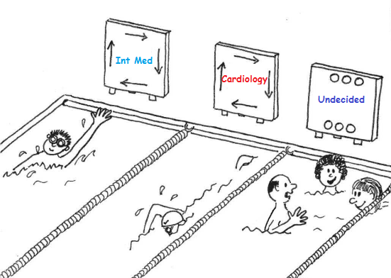
Caveat Emptor

Slide 3
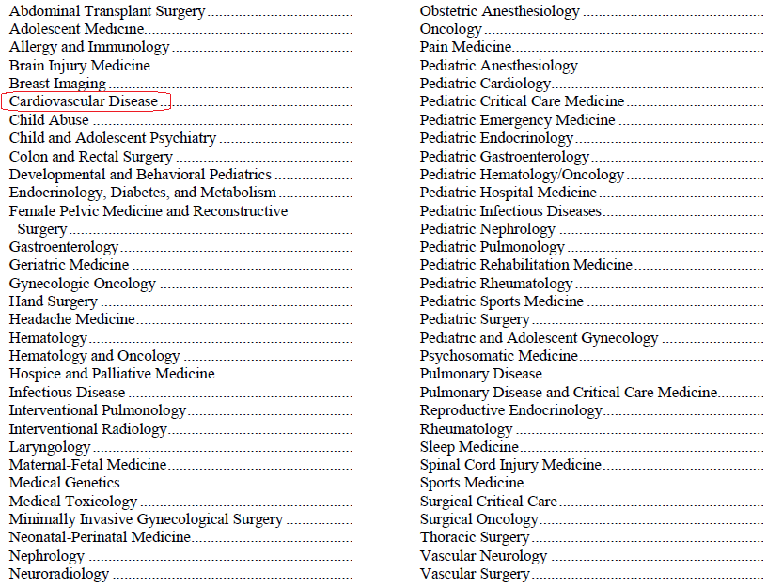
The Choices

Slide 4
The Basic World of Cardiovascular Medicine
Interventional
Coronary intervention
Electrophysiology
Percutaneous valve replacement
Non-Invasive
Stress Tests/Nuclear Studies
Echocardiography
Office Cardiology (complex patients and unexpected walk-ins)

Slide 5
“I like Cardiology because. . .”
Clinically stimulating—many options
Compensation
Lifestyle/Prestige
Surgical component
Other?

Slide 6
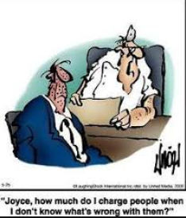
Perspective Changes with Time/Experience
“Last year I matched into a very competitive specialty for an IMG: categorical surgery. I was happy and amazed. Then I started my internship and realized I should have gone with my other choice – medicine. I started thinking, ‘This is it. I will rot in the OR for the rest of my life.’ Then I realized I can live without the OR. I told my PD I wanted to switch.”
-BoardVitals physician
Notes:
What you want to avoid happening . . .

Slide 7
Intangible Pre-requisites for Cardiology
Must be an Adrenaline Junkie
prerequisite to thrive
allows you to tolerate a life of interruption and inconvenience
Mesh Capability With Desire
know what you don't know and what you can't do
important to mesh your capabilities with your desires
Must Like Talking/Explaining to Patients, Family
Must carefully choose Soul Mate
“greatest attribute in a life partner is not their tolerance of your profession, it's their understanding that you are your profession”
find someone who knows that asking you to stop practicing medicine is like asking a musician to put down their instrument
Reciprocate by realizing that family life is not all about you

Slide 8
Adaptability: Life continues to happen. . .
“As a fellow, I was about to bolt out the door to the cath lab when I noticed spots on my 4-year-old's face. Chicken pox blew through all my contingency plans. Innovation and perseverance are key in any profession, but you will need more of it to be a parent and a cardiologist whose schedule is full of procedures that took days or weeks to precertify and plan.”
Melissa Walton-Shirley, MD

Slide 9
Other Adrenaline-filled Specialties
Why not Emergency Medicine?
little follow-up on how patients fared
incessant trail of pregnant 14-year-olds with pelvic inflammatory disease and drug seekers who had "accidentally" flushed their oxycodone.
Why not Pulmonary/Critical Care?
Don’t want to manage sepsis, mechanical ventilation
Work hours

Slide 10
Preparation as a Medical Student
Acquire/Develop strong fundamentals: heart sounds, ECG, clinical exam, pathophysiology, communication
USMLE scores: depends on the fellowship program
Get Research experience: for higher-power programs
Interviews: during PGY 2-3
Emotional Intelligence
Time Management skills: significant other

Slide 11
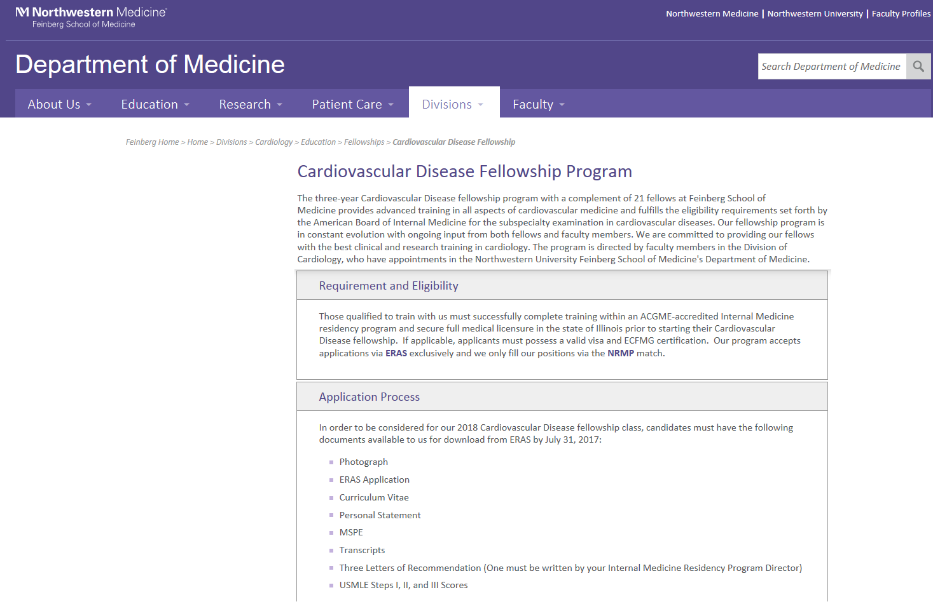

Slide 12
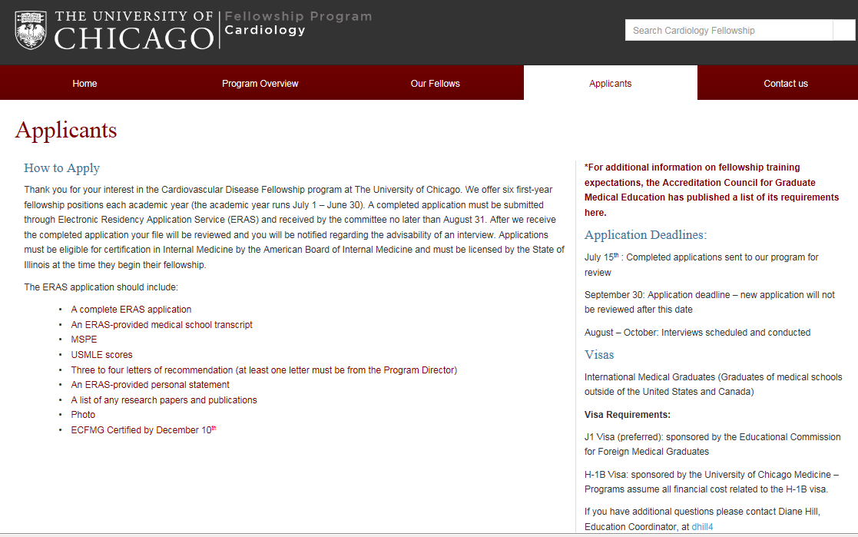
Title and Content Layout with Chart

Slide 13
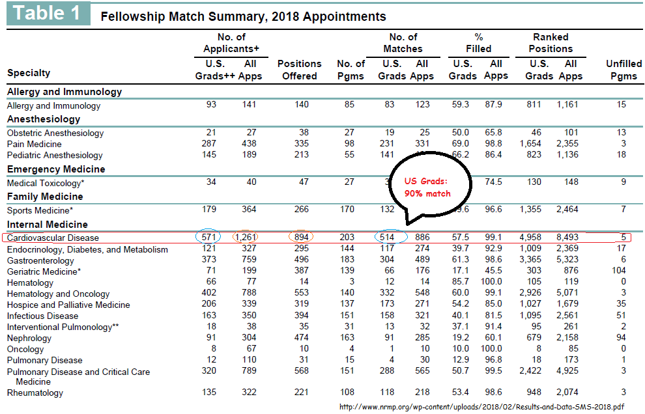

Slide 14
Cardiology How Can I Help as a Medical Student - I?

Slide 15
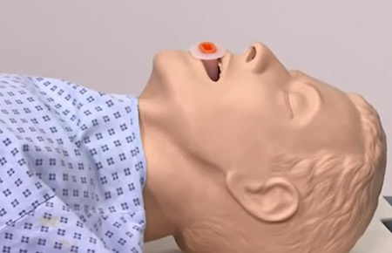
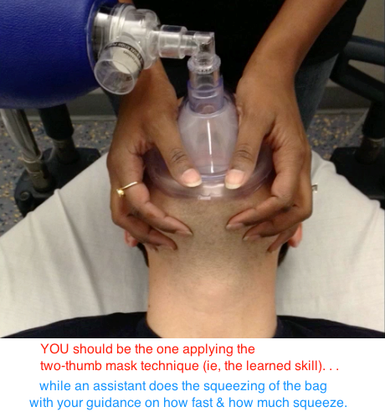
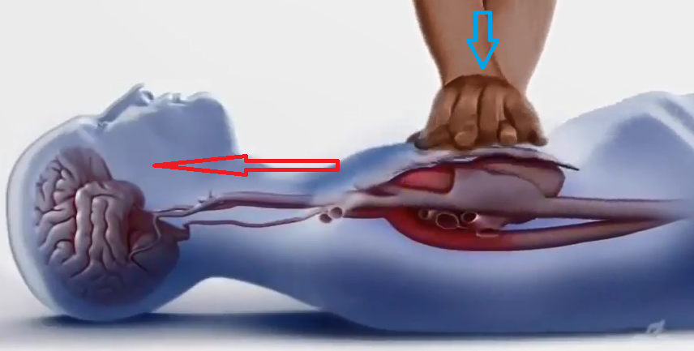
Master the Fundamentals
Optimize delivery of oxygen
Optimize blood flow and perfusion

Slide 16
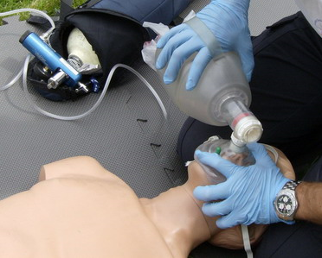
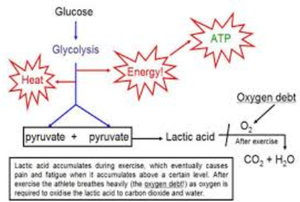
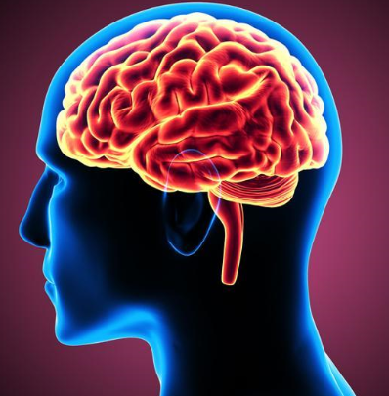
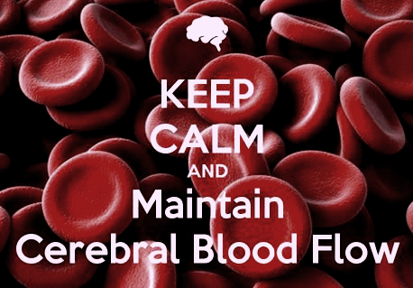
Pearls for the Medical Student as EMT

Slide 17
Blood Flow/Perfusion ACLS/Chest Compressions
CPR really should be called CCR (cardio-cerebral resuscitation)
Video Chest Compressions
When is it OK to stop compressions?
Focus on Compressions
ACLS Updates to know

Slide 18
How Do You Know What You Are Doing Is Actually Doing Something?

Slide 19
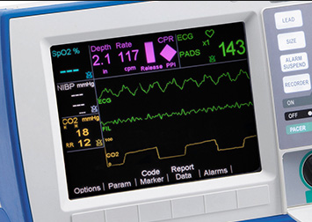
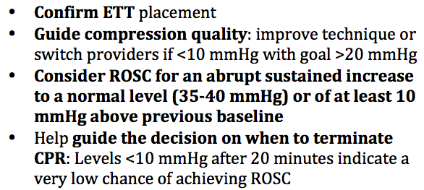
End-Tidal CO2

Slide 20
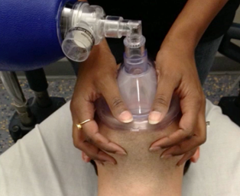
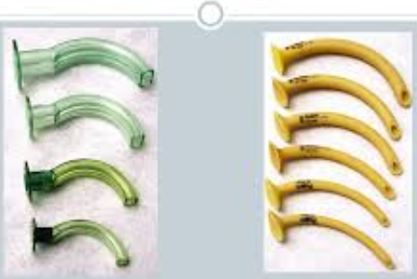
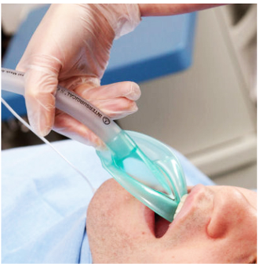
Airway Management Pearls for MS-I
Bag-Valve Mask Ventilation
Oropharyngeal and/or Nasopharyngeal Adjunct
Supraglottic Device/Laryngeal Mask Airway
Endotracheal Intubation

Slide 21
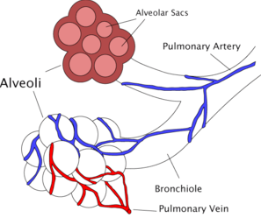
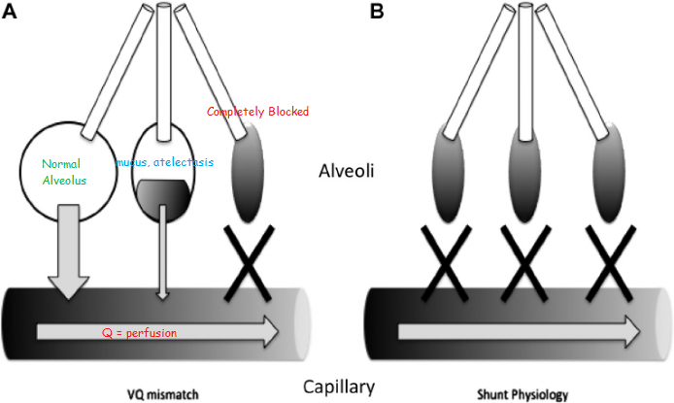
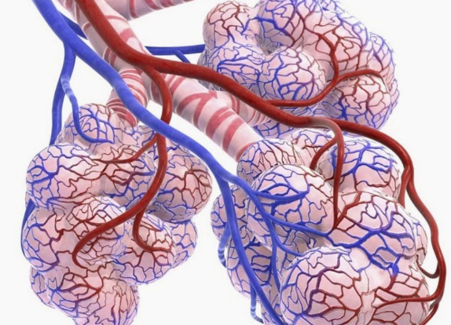
Airway Management for MS-I

Slide 22
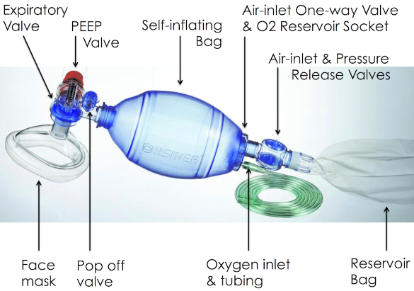
Bag Valve Mask Ventilation
Don’t “bag” faster if pulse oximetry is low. . .
Check pulse oximetry (%) and/or blood gas (PaO2)

Slide 23
Ventilation
Two-Hand Technique
Rescue Breathing: 1 breath every 6 seconds
CPR: 30:2

Slide 24
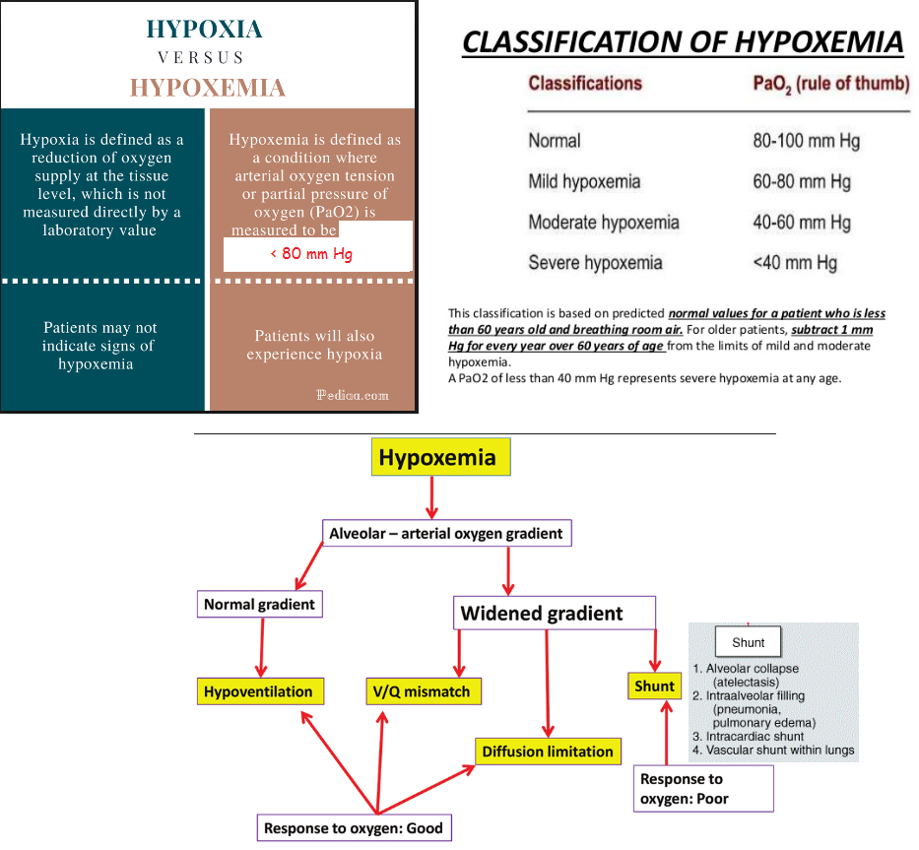
Oxygenation

Slide 25
How Do You Know What You Are Doing Is Actually Doing Something?

Slide 26
End-Tidal CO2
Validate that air is being delivered to the lungs

Slide 27
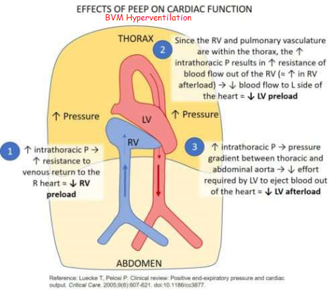
Bagging Too Fast → BP Falls

Slide 28
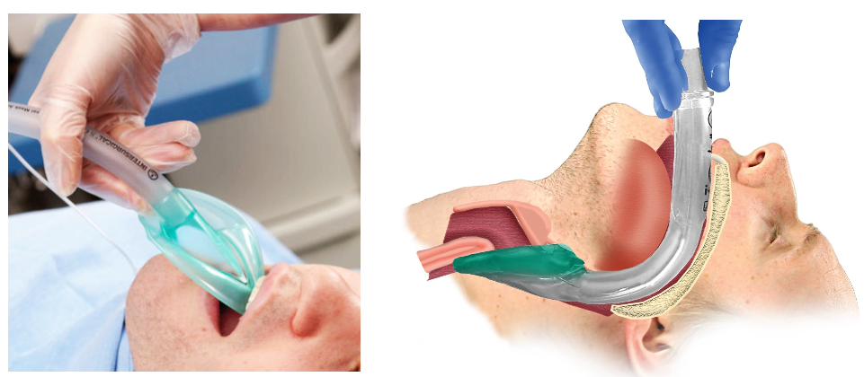
Laryngeal Mask Airway (LMA)

Slide 29
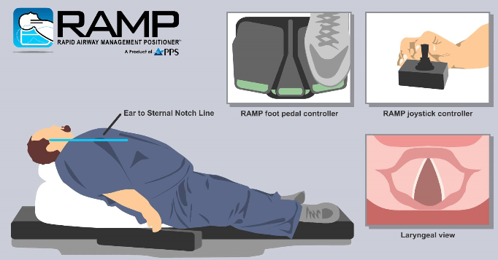
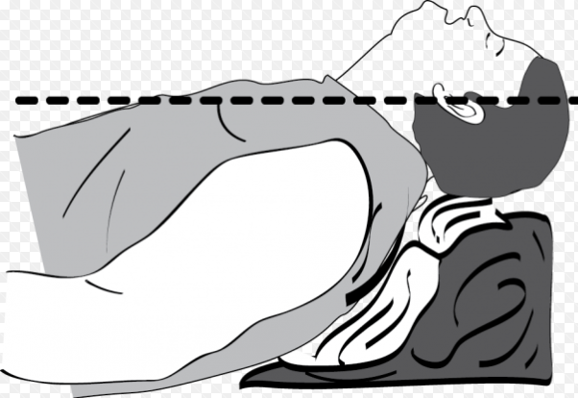
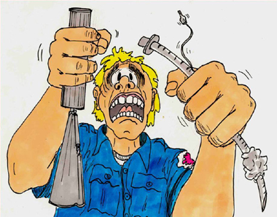

Slide 30
Recognize STEMI vs NSTEMI

Slide 31
Summary

Slide 32
Airway Management Pearls for MS-I
Bag-Valve Mask Ventilation
Oropharyngeal and/or Nasopharyngeal Adjunct
Supraglottic Device/Laryngeal Mask Airway
Endotracheal Intubation

Slide 33
Blood Flow/Perfusion ACLS/Chest Compressions
CPR really should be called CCR (cardio-cerebral resuscitation)
When is it OK to stop compressions?
ACLS reminders

Slide 34
Questions?

Slide 35
Cardiology Survey Data Medscape 2018

Slide 36
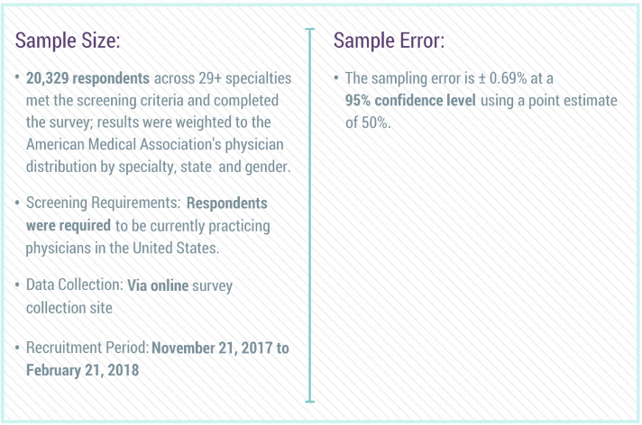

Slide 37
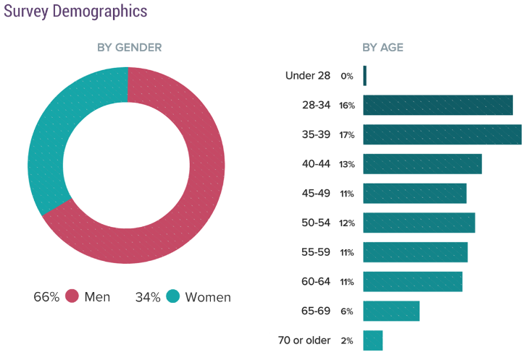

Slide 38
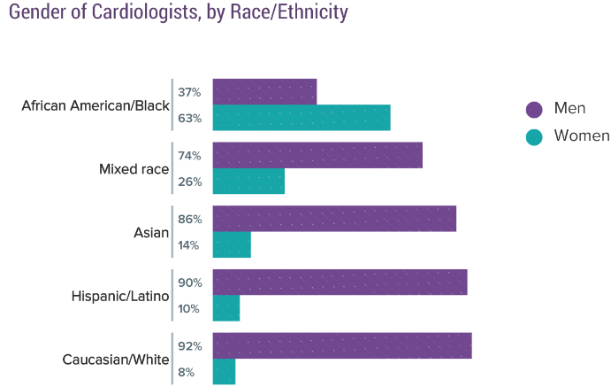
Ethnicity, Diversity, Gender

Slide 39
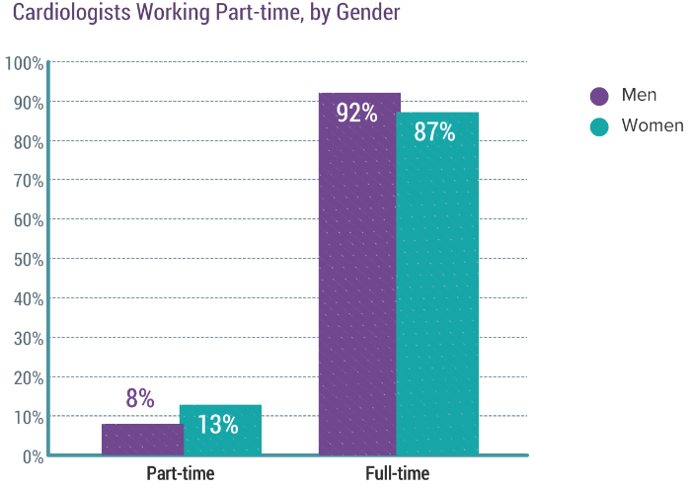

Slide 40
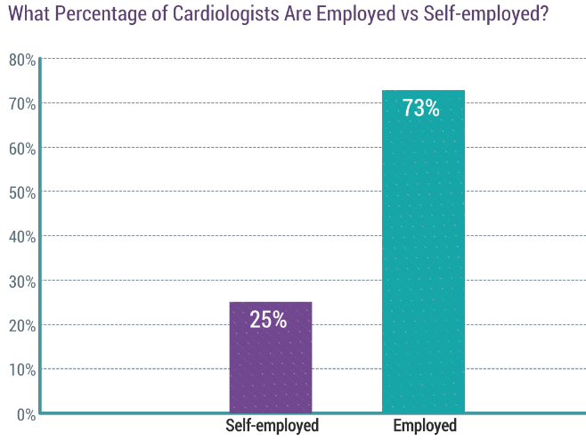

Slide 41
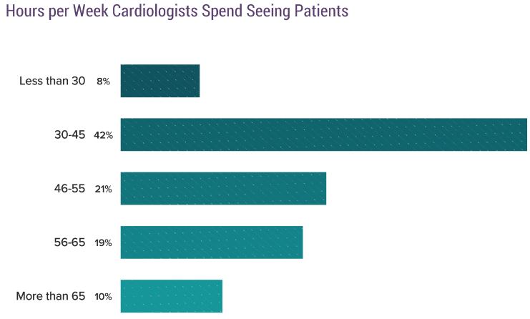
Patient Contact Hours

Slide 42
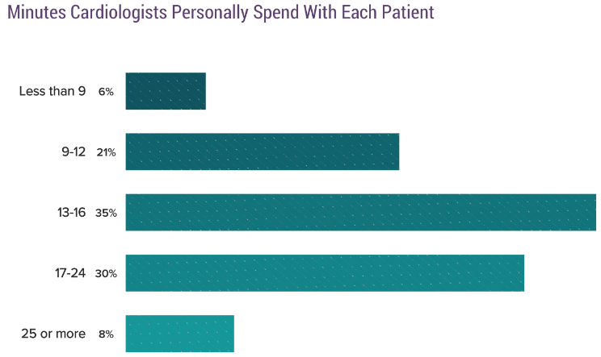
Patient Contact Hours

Slide 43
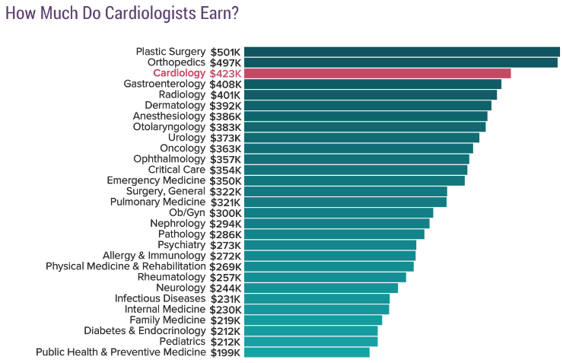
Average Annual Salaries by Specialty

Slide 44
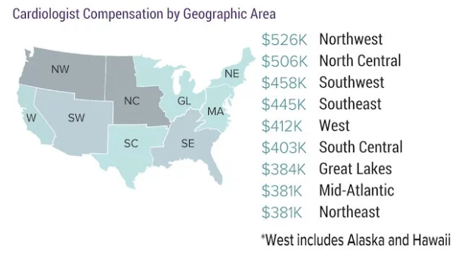
Compensation by Location: 2017

Slide 45
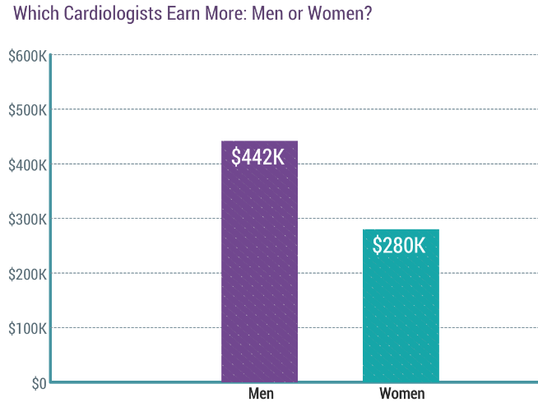
Compensation by Gender

Slide 46
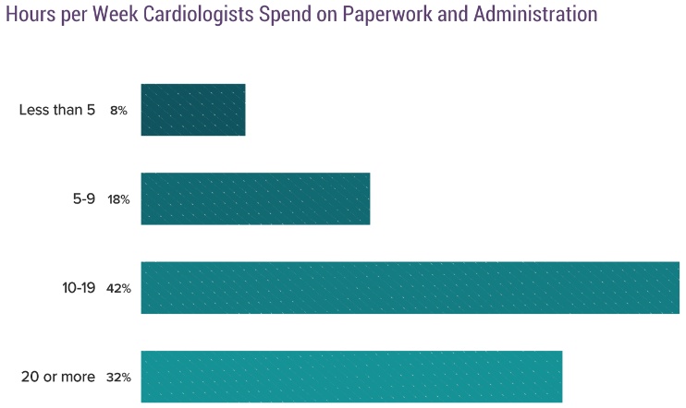
Administrative Burden

Slide 47
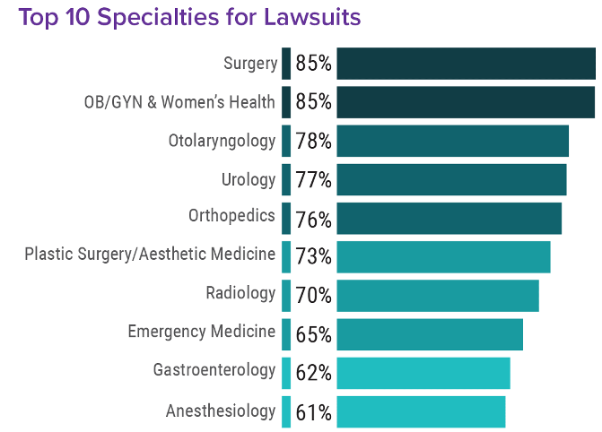

Slide 48
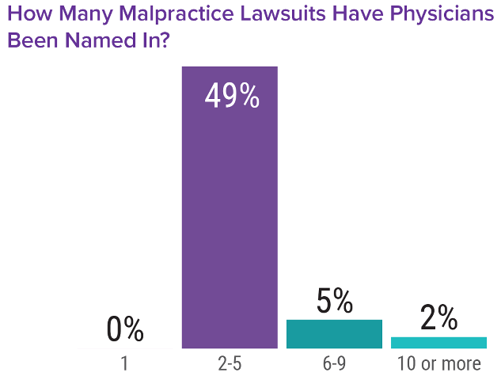
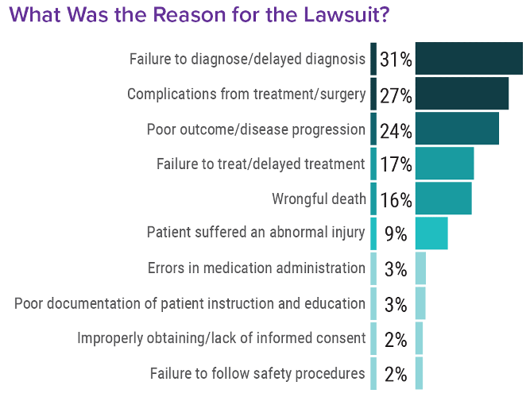

Slide 49
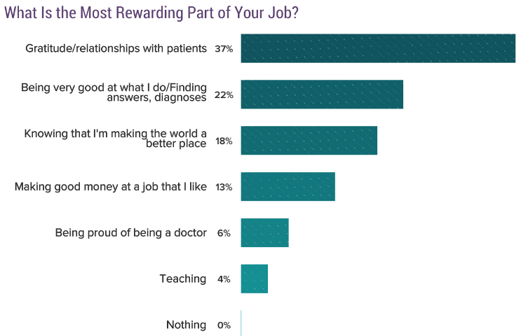
Most Rewarding Aspect

Slide 50
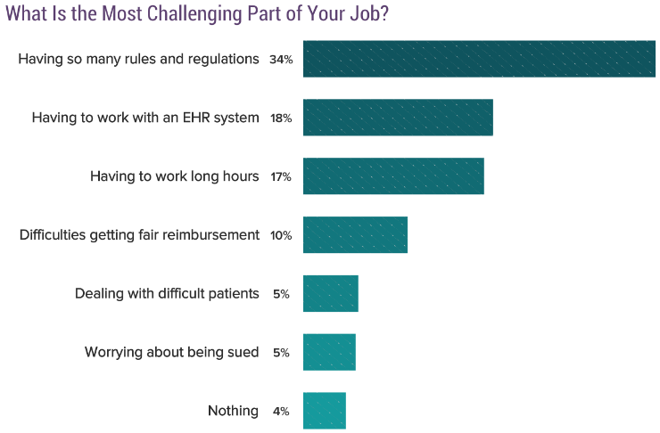
Most Challenging Aspects

Slide 51
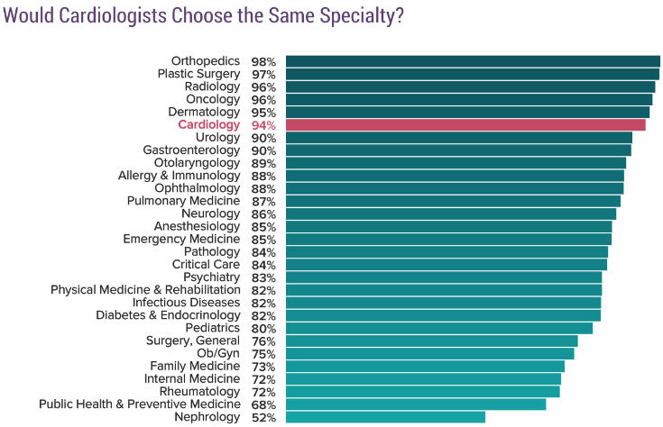
Choose Cardiology Again?

Slide 52
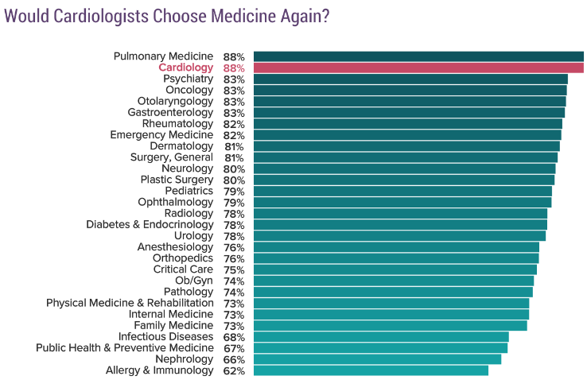
Choose Medicine Again?

Slide 53
References
Walton-Shirley, Melissa. To Be or Not to Be a Cardiologist. January 25, 2017. https://www.medscape.com/viewarticle/874911#vp_2
Results and Data: Specialties Matching Service. 2018 Appointment Year. February 2018. http://www.nrmp.org/wp-content/uploads/2018/02/Results-and-Data-SMS-2018.pdf
Medscape Cardiology Compensation Report 2018. https://www.medscape.com/slideshow/2018-compensation-cardiologist-6009651#2
Medscape Malpractice Report 2017.
https://www.medscape.com/slideshow/2017-malpractice-report-6009206

